Slide 1
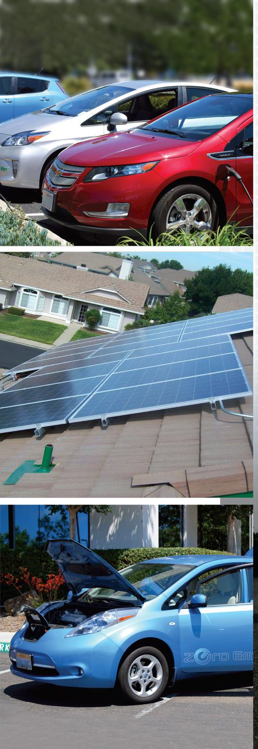
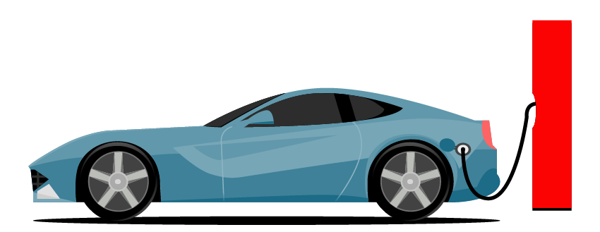
Automobile Manufacturing
Electric Vehicles
Team Optuna

Slide 2
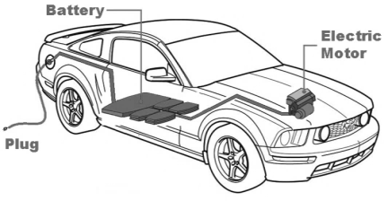
Introduction

Slide 3
Intro
Electric vehicles (EVs) are a promising technology for achieving a sustainable transport sector in the future, due to their very low to zero-carbon emissions, low noise, and high efficiency.
EVs are often presented as a technology option with potential to result in significant reductions in greenhouse gas (GHG) emissions and exhaust TRAP, and therefore potentially resulting in many health benefits
Countries globally have committed to deploy electric vehicles immensely within the decade. However, these deployments at an early stage come at a huge cost to governments.

Slide 4
Project Objectives
Aimed at adding to the already existing body of research work on electric vehicles this project allows insight to be drawn using web data for which of the electric cars have the highest efficiency, fastest acceleration, which manufacturer has the most number of vehicles and how the price relates to rapid charging

Slide 5
Important Features Definition
- Powertrain: refers to a set of components generating power to the vehicles for its operation
- Range: Average distance an electric car can travel on full charge
- Efficiency: basically represents how well the vehicle converts it fuel (electricity) into the actual vehicle movement.
- PlugType: would majorly determine or reflect the speed and voltage of vehicle charge.

Slide 6

Insights and Inferences

Slide 7
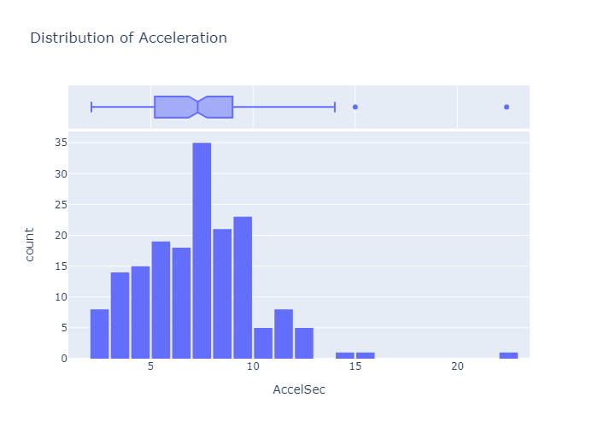
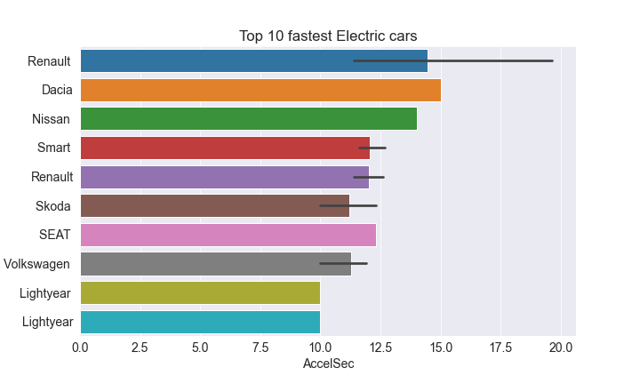
Quick Distribution Check - Acceleration

Slide 8
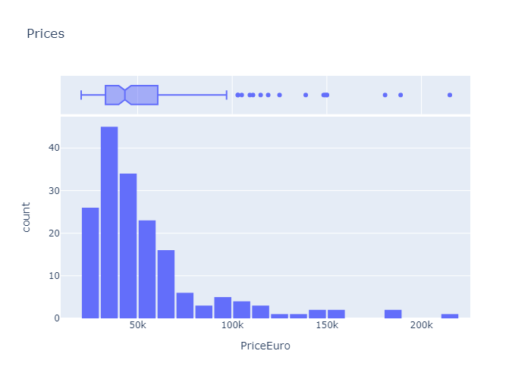
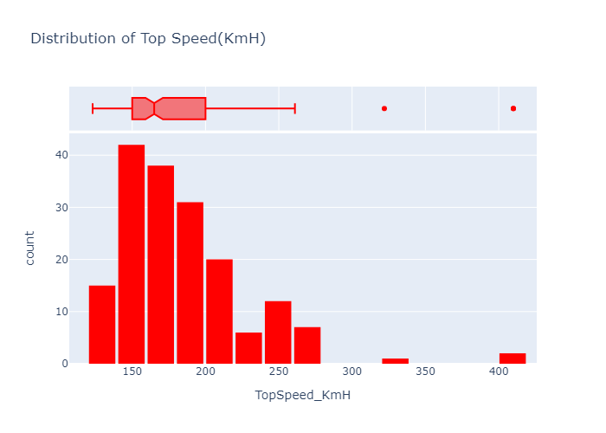
Quick Distribution Check - Price et Speed

Slide 9
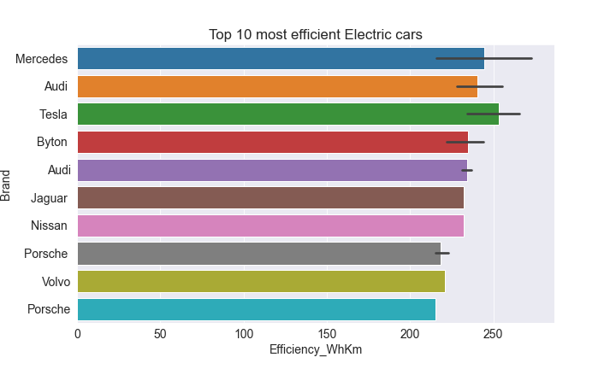
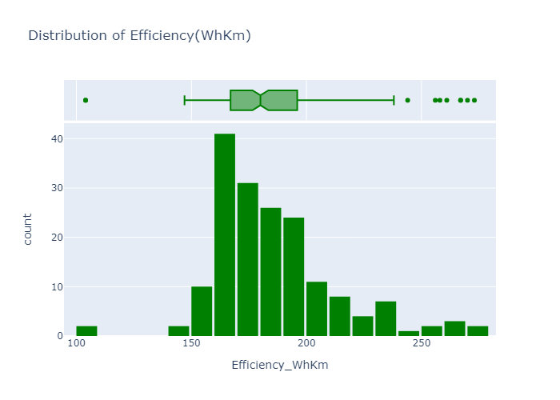
Quick Distribution Check - Efficiency

Slide 10
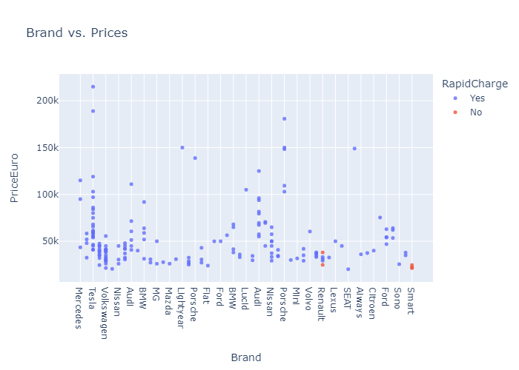
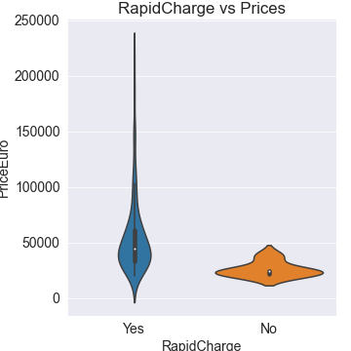
Quick Distribution Check - Rapid Charge

Slide 11
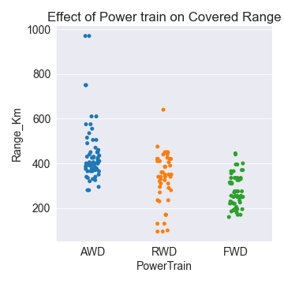
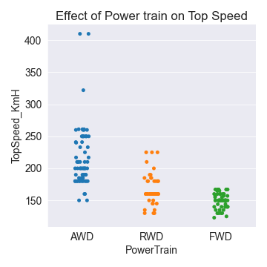
Features Categorical Distribution

Slide 12
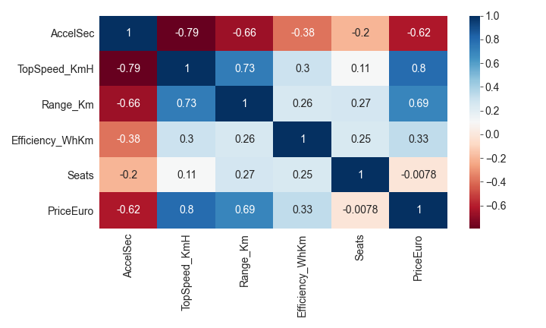
Features Interdependence

Slide 13
Model development

Slide 14
Why develop a model?
Beyond drawing insight from features distribution plots, it is vital to understand how different features of an electric vehicle affects the price. This insight could be useful to consumers, in determining the price ranges of vehicles given its features, and to design engineers for what to take in to consideration during the design process.

Slide 15
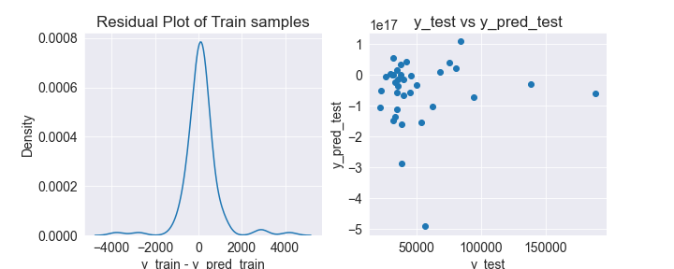
Developed Models - Baseline (LinReg)

Slide 16
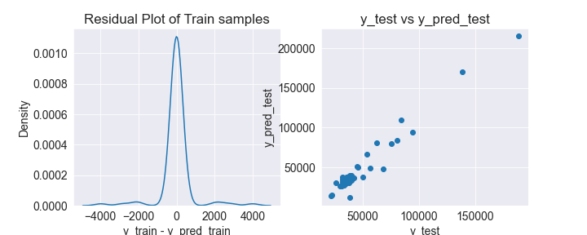
Developed Models - Final (GradB. Reg)

Slide 17

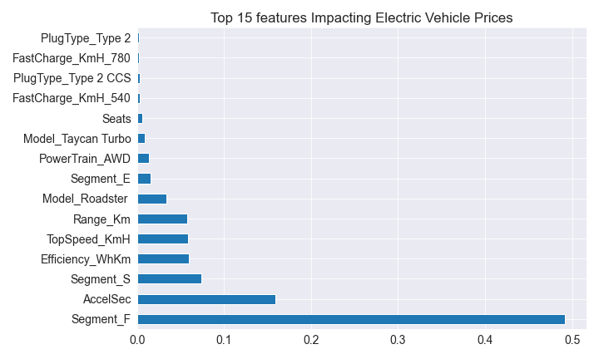
Model Inferences

Slide 18
“EV are a necessity for the energy transition to a zero-carbon energy future.”
- Evanthia A. Nanaki, 2021

Slide 19

Thanks!
Contributors:
Oladiran Matthew O.
Oluwabunmi Iwakin
Aditya Kumar
Phebian Nwokeji
Adarsh Dhir
Vaibhav Arekar
Jennifer Serao
Find all codes and executables here

